Slide 1
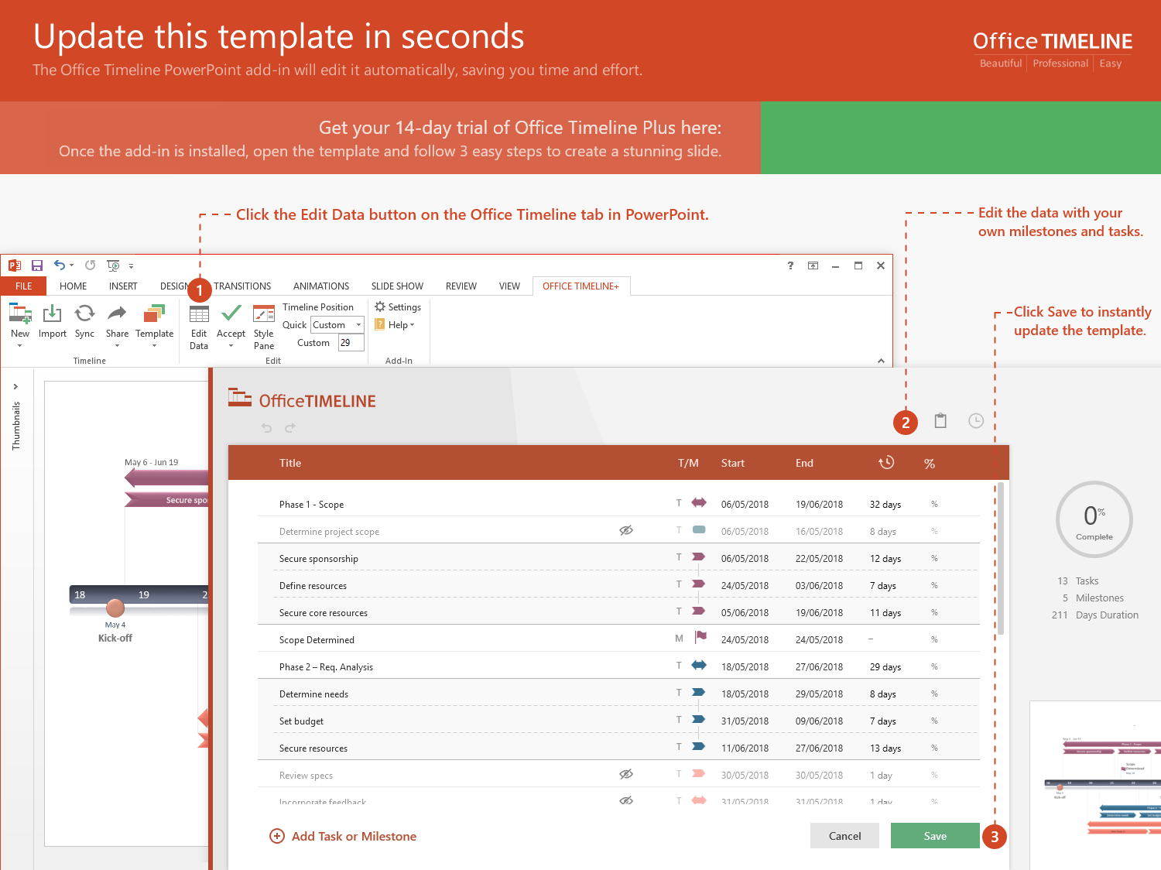
https://www.officetimeline.com/14-days-trial

Slide 2
Project Plan
Sep 8 - Oct 7
Task 2 Here
30 days
Oct 4 - Nov 16
Task 4 Here
44 days
Milestone 1
Milestone 3
Milestone 7
Sep 8
Oct 4
Milestone 5
Nov 21
Nov 4
2019
2019
Sep
Oct
Nov
2019
Today
Sep 21
Oct 12
Nov 10
Milestone 2
Milestone 4
Milestone 6
Nov 30
Milestone 8
Sep 16 - Oct 2
Task 1 Here
17 days
Sep 27 - Oct 20
Task 3 Here
24 days
Nov 1 - Nov 20
Task 5 Here
20 days
Nov 12 - Nov 28
Task 6 Here
17 days

